Slide 2
Disability Resource (DR) Office
We coordinate services and academic accommodations for USI students with disabilities.
We ensure equal access to facilities, programs, services, and university resources.
For students to work with DR, they must present documentation of a disability.

Slide 3
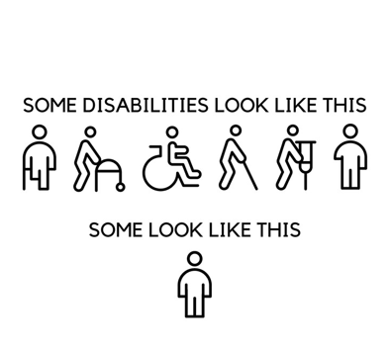
What is a disability?
The federal definition of a disability is a physical or mental impairment that substantially limits a major life activity.
Alt text: Illustrated representation of visual and non-visible disabilities

Slide 4
Laws That Govern the DR Office
Section 504 of the Rehabilitation Act passed in 1973
Americans with Disability Act (ADA) passed in 1990 and amended in 2008
An individual with a disability is defined by the ADA as a person who has a physical or mental impairment that substantially limits one or more major life activities.
Major life activities include, but are not limited to, caring for oneself, performing manual tasks, seeing, hearing, eating, sleeping, walking, standing, lifting, bending, speaking, breathing, learning, reading, concentrating, thinking, communicating, and working.

Slide 5
Required Documentation
Students must provide documentation of a disability provided by an appropriately licensed professional.
We do not accept IEP and 504 plans as the only source of documentation. The verification form needed to determine what accommodations you are eligible for, can be found on the DR website.
Common sources of documentation are health care providers, psychologists, diagnosticians, or information from a previous school.

Slide 6
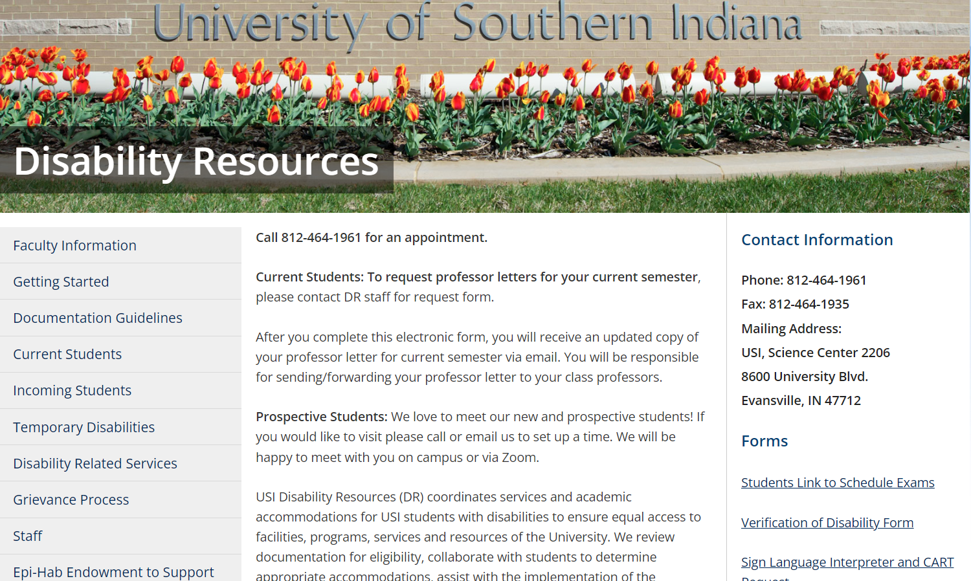
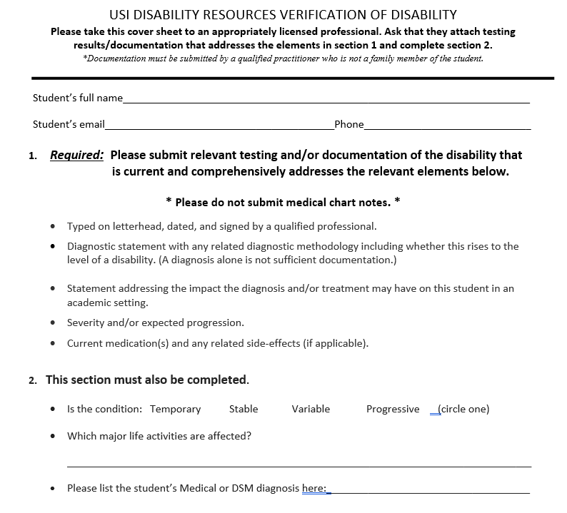

Slide 7
We work with students who have a variety of disabilities
Autism
ADD/ADHD
Concussion/Brain Injury
Hearing/Vision Impairment
Health Impairment
Learning Disability
Psychological

Slide 8
How would these accommodations create better access for a student who has a disability?
Extra time on exams
Reduced distraction area for testing
Peer note-taker
Reader for exams
Sign-language interpreters
Captions for videos

Slide 9
Collaboration with other departments
Career Services
Counseling
Dean of Students
Housing and Residence Life
Registrars Office
Public Safety
Sodexo

Slide 10
Three types of animals on campus
Emotional Support Animals
Service Animals
Therapy Animals

Slide 11
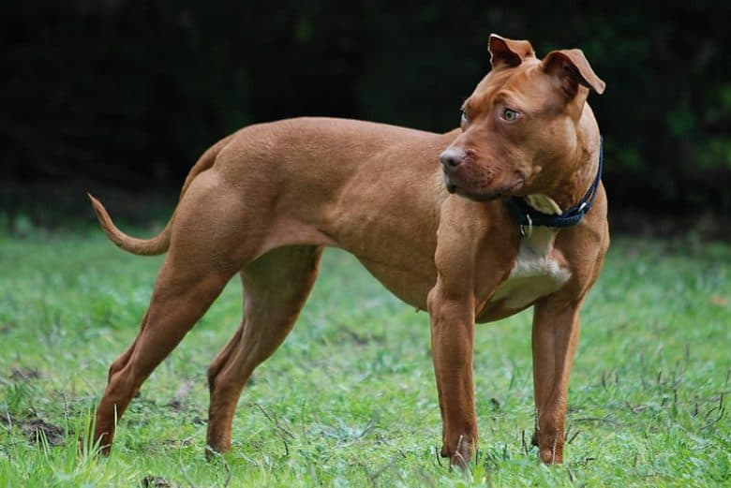
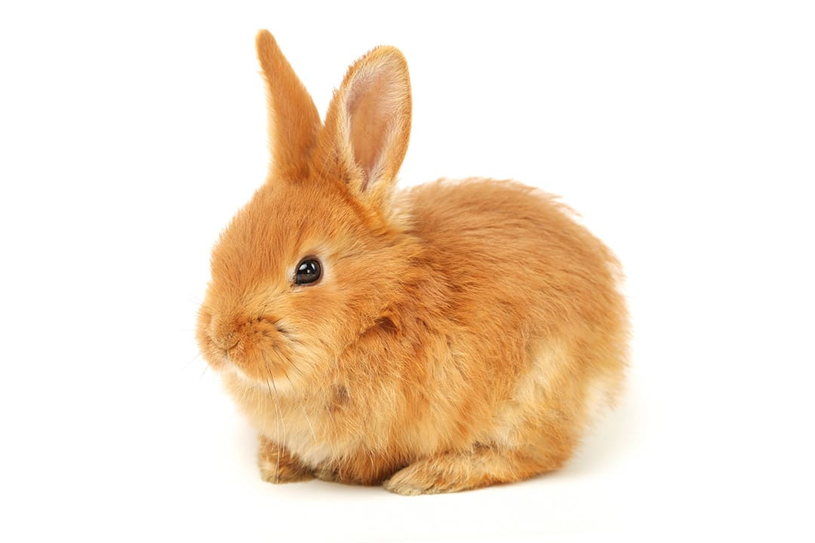
What category would these animals fit into?
Alt text: A brown dog standing in grassy area
Alt text: A black cat with green eyes
Alt text: A brown bunny with big ears

Slide 12
Emotional Support Animals (ESA)
These are animals by their presence provide therapeutic benefits such as alleviating some symptoms of a disability to an individual with an emotional or psychiatric disability. An ESA could be most any type of animal that can reasonably and safely be kept in small areas.
Students would need to proceed with the following steps for an ESA approval:
Submit documentation of a qualifying disability to DR.
Meet with DR.
Meet with HRL.
*Only allowed in HRL.

Slide 13
Service Dogs
These are dogs and in extremely rare circumstances miniature horses. Service animals must be trained to perform a task for an individual with a disability. For example: A guide dog can be trained to guide someone with a visual impairment.
Service dogs can go anywhere with the individual and no documentation or permission is needed.
Alt text: Dog wearing service animal vest

Slide 14
Therapy Animals
Therapy animals are certified to go to locations such as long-term care facilities to provide temporary comfort and companionship. USI brings therapy dogs to campus several times throughout the year, usually close to final weeks.
Alt text: Dog being pet by multiple individuals

Slide 15
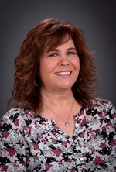
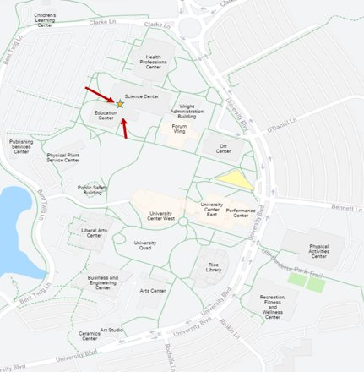
USI Disability Resources
Michelle Kirk– Manager
mdkirk@usi.edu
Keith Scheller– Coordinator
kascheller1@usi.edu
Michele Barnett – Senior
Administrative Assistant
mrbarnett@usi.edu
Science Center 2206
812-464-1961

