Slide 1
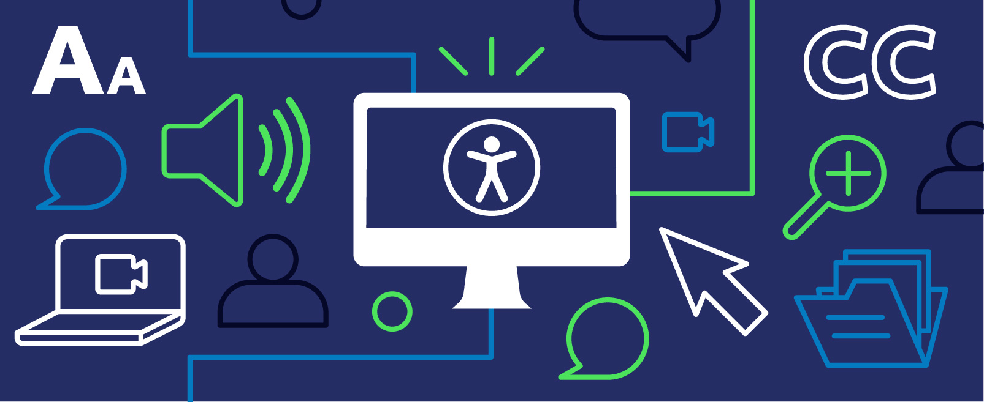
Accessibility Compliance: ADA Title II and Tools for Success Shannon Hoehn & Walter Fisher

Slide 2
Session Objective
Understand ADA Updates
Learn practical accessibility tips
Explore Anthology Ally features in Blackboard
Explore Adobe Acrobat Pro accessibility features
I want to start with a simple idea: When our courses live online, online access is access to education.

Slide 3
ADA TITLE II FINAL RULE OVERVIEW
The Department of Justice finalized a new rule under ADA Title II, to make sure public entities, including universities, deliver websites and mobile apps that people with disabilities can use independently, privately, and equally. This means our digital materials must meet WCAG 2.1 Level AA standards, the widely accepted benchmark for accessible content, by April 24, 2026.
WCAG 2.1 AA is the technical standard for state and local governments’ web content and mobile apps.
State and local governments’ web content usually needs to meet WCAG 21. AA standards
The rule applies to web content that a state or local government provides or makes available. This includes 3rd party sites.
State and local governments’ mobile apps usually need to meet WCAG 2.1 AA standards
The rule applies to mobile apps that a state or local government provides or makes available. This includes 3rd party apps.
Accessibility Policies and Statements – List for most course technologies used.

Slide 4
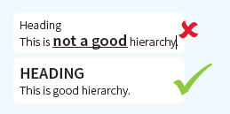
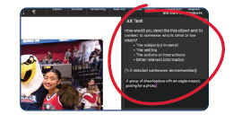
Creating Inclusive Documents
Headings and Tags: Headings create a logical blueprint of your document (structure and hierarchy). Tags identify content elements.
2. Images: Alt text is a simple, concise description of the image.

Slide 5
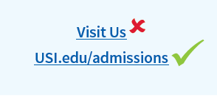
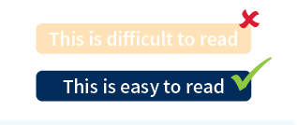
Creating Inclusive Documents, slide 2
3. Links: Your link text must be descriptive, telling the user the destination.
4. Color (strong contrast): People with visual impairments may not be able to read low contrast text.

Slide 6
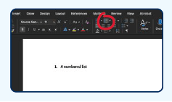
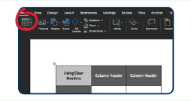
Creating Inclusive Documents, slide 3
Lists: Always use the software's built-in list tools (bullets or numbering, etc.). The computer will automatically handle the numbering and structure.
6. Tables: Only use the software’s built-in table tool to display tabular data. Include meaningful headers to rows and columns.

Slide 7
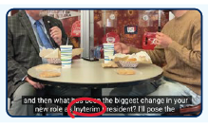
Creating Inclusive Documents, slide 4
7. Video/Audio: make sure all videos are captioned and provide transcripts for audio-only files. If you create videos through
VoiceThread, you will have automatic captions.
Create Inclusive Documents in 7 Easy Steps (Michelle Kirk, Disability Resources)

Slide 8
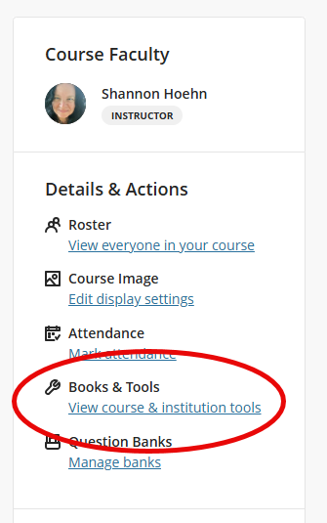
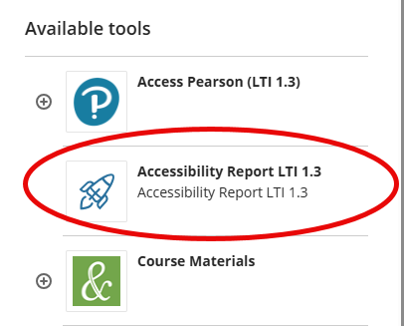
Anthology Ally in Blackboard
Our Future Students
Anthology Ally (housed within Blackboard) scans your course files, flags issues, offers step-by-step fixes, and provides alternative formats for students. It also gives USI an institutional dashboard to monitor accessibility progress.
Types of files checked by Ally:
PDF Files
Microsoft Word Files
Microsoft PowerPoint Files
OpenOffice/LibreOffice Files
Uploaded HTML Files
Image files (JPG, JPEG, GIF, PNG, BMP, TIFF)
WYSIWYG/VTBE Content (What You See Is What You Get)/Visual Text Box Editor
YouTube videos embedded in WYSIWYG/VTBE Content

Slide 9
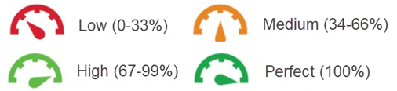
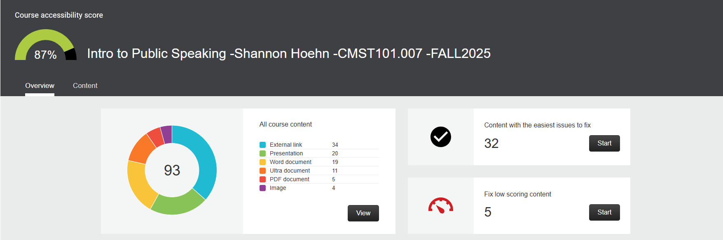
Anthology Ally in Blackboard, slide 2
Our Future Students
Ally Accessibility Score: To measure accessibility, Ally assigns your new and existing course content an accessibility score. This accessibility dashboard allows you to quickly find and fix accessibility issues within your course.
Features and New Releases: Anthology Ally Product Roadmap (September 2025)

Slide 10

Adobe Acrobat Pro
Adobe Acrobat Pro (licensed version) – lets you check and repair PDF’s, set the document language, fix reading order, add tags, and run an accessibility check to confirm your file meets standards
Automated Accessibility Features
The Prepare for Accessibility feature automates tagging, reading order, and alternative text to improve PDF accessibility.
Accessibility Compliance Checking
The Accessibility Checker verifies PDF compliance with WCAG and PDF/US standards, offering detailed reports and guidance
Additional Accessibility Tools
Tools to fix form navigation, set document language, and ensure screen reader compatibility enhance overall accessibility.
Adobe Acrobat Pro Help Site
USI signed a site license contract with Adobe which allows USI to offer license access to Adobe Acrobat Professional 2020 for University employees.
Request Access to Adobe Site License Software – submit the Team Dynamix service request and once a license has been applied, you will receive and email from Adobe with instructions on how to download for use.

Slide 11
Additional Resources
ADA Fact Sheet from ADA.gov
USI Tech Takeaways YouTube Channel
Anthology’s Ally Help Center
Ally for LMS Help for Instructors (Blackboard)
Adobe Acrobat Pro Help Site

Slide 12
Thank you for attending?
Any questions for us?
Our question to YOU:
What would you like to see?

