Slide 1
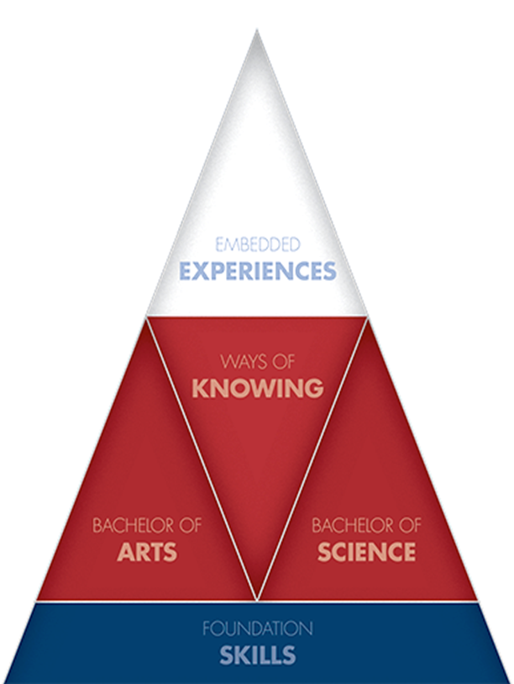
CORE 39 Ways of Knowing Assessment Training
September 22, 2015

Slide 2
Background

Slide 3
How We Got to Now
The CORE 39 Assessment Task Force was created at the end of the 2015 Spring Semester. The group was charged with streamlining the core assessment process.
Three principles guided the work of the Task Force: simplicity, transparency, and less burdensome for faculty.

Slide 4
How We Got to Now
Assessment. To simplify the process, the Task Force recommended that each CORE course will have a Key Assignment that is aligned to a rubric for each part of the CORE.
Rubrics. The Task Force developed rubrics for the four outcomes of the Ways of Knowing, the three embedded experiences. The rubrics are nested in the goals, objectives, and outcomes for CORE 39.

Slide 5
How We Got to Now
The University has contracted with Tk20 to provide us with assessment software.
In most cases:
Students will submit their Key Assignment in Tk20 via Bb.
Faculty will grade the Key Assignments in Tk20 via Bb.
Tk20 training will take place later this semester once the rubrics have “gone live.”

Slide 6
DEADLINES, FALL 2014

Slide 7
Deadlines
September 15: Submit WOK Outcome that will be used to assess your WOK course.
October 9: Submit your Key Assignment directions/guidelines to your CCAF.
October 23: Receive feedback on your Key Assignment from the CCAF (re: Alignment with rubric).
October 30: Return modified Key Assignment to CCAF (only if necessary).

Slide 8
Deadlines
Administer the Key Assignment and score rubric by the end of the semester.
December 23: WOK Faculty should have Assessment rubrics completed.
January 1, 2016: List of missing assessment materials submitted to the UCC Director.

Slide 9
Rubrics and core 39 assessment
Rubric: A guide listing specific criteria for grading or scoring academic papers, projects, or tests.– Merriam-Webster Dictionary

Slide 10
Rubrics are often used to grade student work but they can serve another, more important, role as well: Rubrics can teach as well as evaluate. When used as part of a formative, student-centered approach to assessment, rubrics have the potential to help students develop understanding and skill, as well as make dependable judgments about the quality of their own work. Students should be able to use rubrics in many of the same ways that teachers use them—to clarify the standards for a quality performance, and to guide ongoing feedback about progress toward those standards. – Rubistar (University of Kansas)

Slide 11
Ways of Knowing
OUTCOME 1: Students will be able to utilize problem solving, the process of designing, evaluating, and implementing a strategy or strategies to answer an open-ended question or achieve a desired goal, as defined by the way of knowing.
OUTCOME 2: Students will be able to apply methods of inquiry and analysis, the systematic process of exploring issues/objects/works through the collection and process of breaking complex topics or issues into parts to gain a better understanding of them that result in informed conclusions/judgments, as identified by the way of knowing.

Slide 12
Ways of Knowing
OUTCOME 3: The student will demonstrate the ability to know when there is a need for information, be able to identify, locate, evaluate, and effectively and responsibly use and share that information for the problem at hand.
OUTCOME 4: The student will design and execute a performance of the way of knowing. A performance is defined as: A dynamic and sustained act that brings together knowing and doing (creating a painting, solving an experimental design problem, developing a public relations strategy for a business, etc.); performance makes learning observable.

Slide 13
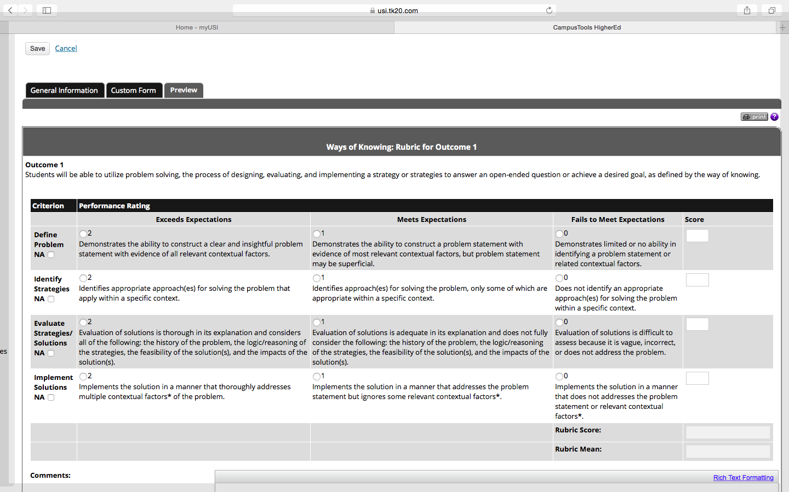
Screen Shot, WOK Outcome 1

Slide 14
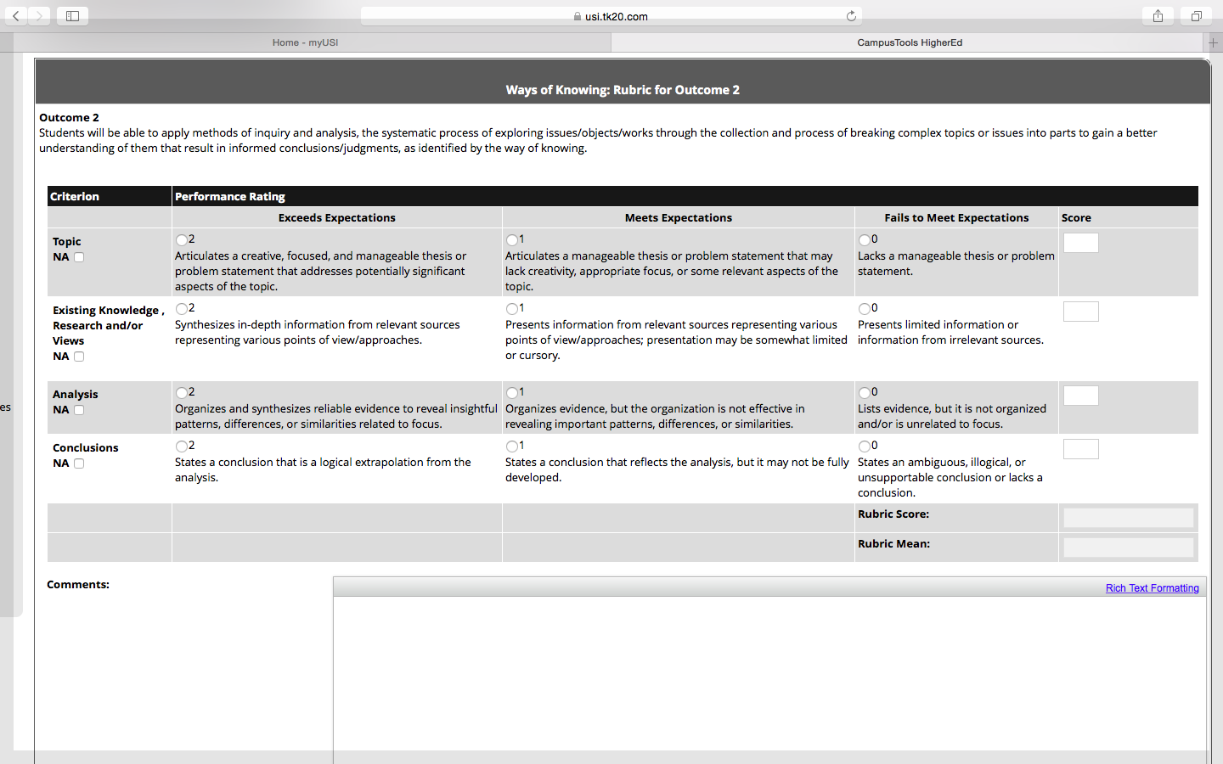
Screen Shot, WOK Outcome 2

Slide 15
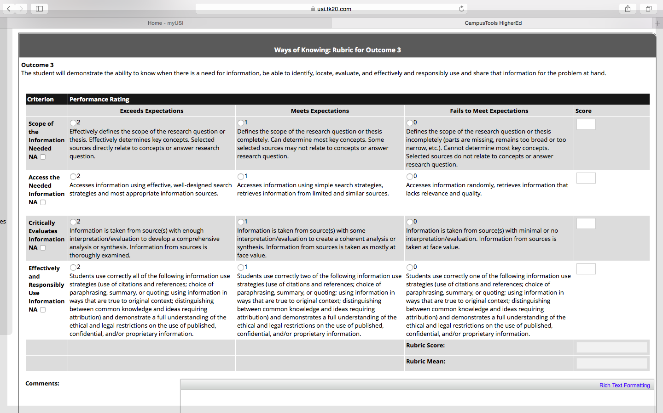
Screen Shot, WOK Outcome 3

Slide 16
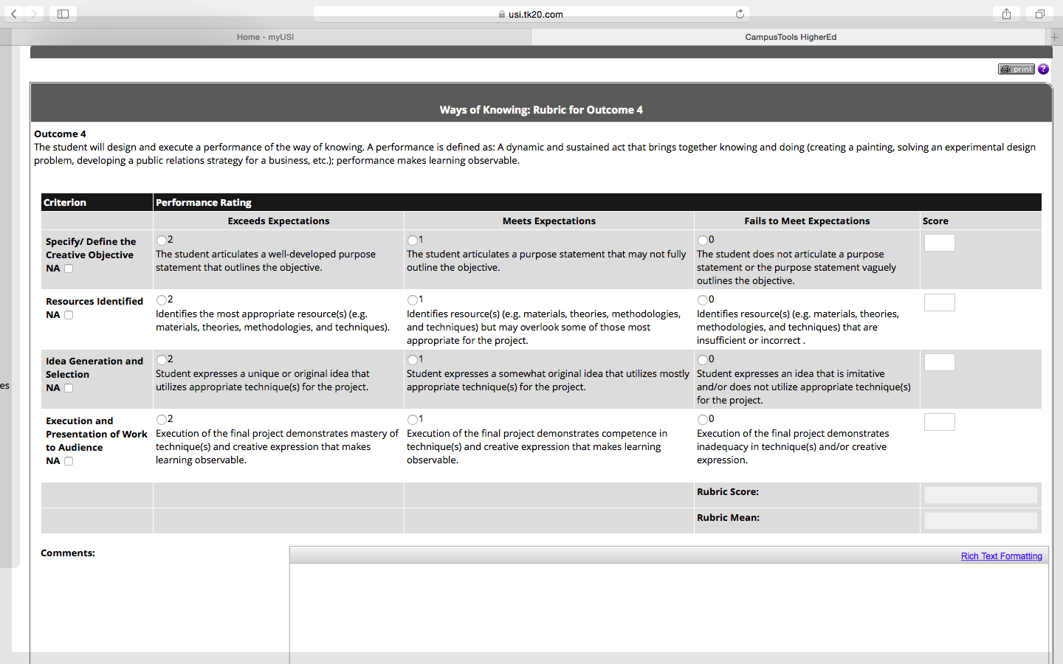
Screen Shot, WOK Outcome 4

Slide 17
A Few Things about Tk20 {We are still working out the details}
In most cases:
Our intent is for the students to submit their Key Assignment by linking to Tk20 through Bb.
Our intent is for the faculty members to be able to complete the rubrics by linking to Tk20 through Bb.
Tk20 can be accessed through MyUSI using your user name and password.

Slide 18
Aligning Your Key Assignment Examples Developed by Dr. Tamara Hunt

Slide 19
Where to get Information

Slide 20
The Core 39 Website
Core 39 Rubrics: http://www.usi.edu/core39/core-39-assessment-rubrics
Core 39 Assessment Overview (In Progress): http://www.usi.edu/core39/core-39-assessment-process
The History of Core 39: http://www.usi.edu/core39/the-history-of-core-39
Core 39 Course Petition Process: http://www.usi.edu/core39/core-39-course-petition-process

Slide 21
Your CCAFs
Liberal Arts:
Tamara Hunt (tlhunt@usi.edu)
Joseph Uduehi (juduehi@usi.edu)
Nursing and Health Professions:
Julie McCullough (jmccullo@usi.edu)
Pott College:
Doris Mohr (djmohr@usi.edu)
Jean Moore (jmoore@usi.edu)
Romain College:
Manfen Chen (mwchen@usi.edu)

Slide 22
Other Contacts
Outreach & Engagement (BPS Program): Lee Ann Shafer(lshafer@usi.edu)
University Division (UNIV 101): Brody Broshears (mbroshears@usi.edu)
Director of University Core Curriculum (Core 39): MT Hallock Morris (mhmorris@usi.edu)
OPRA Research Associate: Gregory Johnson (gregory.johnson@usi.edu)

Slide 23
Questions?

