Slide 1
Attendance Policy 2019 Updates
Facility Operations and Planning

Slide 2
2019 Revisions
Most revisions were intended to provide clarification
Most revisions were a direct result of feedback from FOP employees and supervisors
Revisions take effect January 1, 2019
This presentation will highlight changes only. A copy of the updated policy and presentation will be sent to all FOP employees via e-mail and posted on the FOP web page.

Slide 3
Department Notification Procedure
Employees are expected to call in and report their absence each day they are absent UNLESS they notify FOP of their expected date of return
HVAC employees scheduled to work in the Control Room are required to report an unscheduled absence by contacting the FOP attendance line and the Control Room to notify the Operator on duty
To request off one (1) day or less, employee must submit notice within the first 2 hours of their shift one working day prior to the day requested off
Example: an employee who works 8am to 4:30pm should submit a request by 10am on Thursday if they would like to request to use vacation leave on Friday.

Slide 4
Department Notification Procedure
Supervisors are encouraged to exercise judgment and discretion when determining whether to approve a request that falls outside the guidelines
Supervisors are expected to notify an employee if a leave request is approved or denied within 24 hours or as soon as reasonably possible. If an employee does not receive a timely response to a submitted leave request, he/she is expected to follow-up with the supervisor and confirm the approval or denial before taking the time off.
In the event a supervisor is out of the office or otherwise unavailable to evaluate a leave request, the second level supervisor should be consulted
Second level supervisor = your supervisor’s supervisor

Slide 5
Occurrences
Although occurrences will be tracked on a quarterly basis, supervisors are expected to notify employees as soon as an occurrence(s) has been accrued.

Slide 6
Pattern Absence
A pattern absence(s) may result in the absence being counted as an unscheduled absence, and may result in the accrual of an occurrence(s).

Slide 7
No Call / No Show
When a FOP employee does not report to work within one (1) hour of the scheduled shift start time and has not called in, the Lead or Supervisor is expected to reach out to the employee as soon as practical. If contact is made with the employee, the supervisor should inquire if the employee plans to report to work and, if so, by when.
If employee reports to work within the first four (4) hours of the scheduled shift, he/she will accrue two (2) occurrences
If the employee does not report to work or reports to work after the first four (4) hours of the scheduled shift, he/she will accrue four (4) occurrences

Slide 8
Making up Missed Time
A FOP employee that accrues an occurrence for an unscheduled absence or tardy will not be allowed to make up the missed time during the workweek in which the occurrence was accrued.
Depending on the time the employee arrives to work, he/she may be required to use vacation time or comp time (rounded to the nearest .25 hour increment) to cover the time missed.
Sick leave should be used to cover the time missed if the unscheduled absence was due to an illness or medical/dental appointment of the employee or an eligible family member, in accordance with the University Handbook.

Slide 9
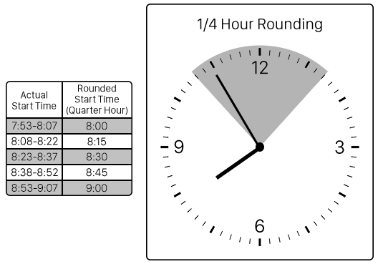

Slide 10
Blackout Periods
An unscheduled absence that occurs during a blackout period may be subject to verification and/or disciplinary action.

Slide 11
2019 Blackout Periods
Department | Blackout Periods
Custodial (all shifts) | Week of Fall and Spring Commencement (4/21/19 – 4/26/19) and ( 12/1/19 – 12/6/19) First week of Fall and Spring semesters (8/18/19 – 8/23/19) and (1/12/20 – 1/17/20)
Distribution Services | NONE
Grounds | Week of Spring Commencement (4/22/19 – 4/26/19) Week of Move-In and Week of Move-Out (4/29/19 – 5/3/19) and (8/12/19 – 8/16/19) Spring Spruce-up Day (4/7/19)
Housing Maintenance | Spring Blitz (first week of May) (5/6/19 – 5/11/19) Weekend before Move-In, Week of Move-In Week, and Weekend after Move-In (8/10/19 – 8/18/19)
HVAC | Weekend before, week of, and weekend after Fall Move-In (8/10/19 – 8/18/19) Those scheduled in Control Room may have separate blackout periods (e.g., holidays)
Maintenance | NONE
New Harmony | Heritage Artisans Day event (3rd full week of April – Tuesday to Thursday) Maintenance staff required the week before the event and work days(s) prior to the event (4/8/19 – 4/12/19 and 4/15/19) Custodial staff required the 3 days of the event, and the Saturday after the event (4/16/19 - 4/18/19 and 4/20/19)
Storeroom | NONE

Slide 12
Essential Personnel
Essential personnel may be required to report for essential duty (e.g., report to work before the scheduled shift start time or stay after the scheduled shift end time) if inclement weather or another emergency is forecast, but there is no cancellation, delayed opening, or campus closing.
Supervisors are expected to maintain an updated contact list for essential employees; essential employees are responsible for communicating any changes to their contact information to the Supervisor in a timely manner
Essential personnel who cannot be located or fail to report to work (or fail to remain at work) at any time when essential staff are required to be at work will be subject to four (4) occurrences for each incident.

Slide 13
Essential Personnel
For safety purposes, FOP employees whose responsibilities may require them to work more than 12 consecutive hours in a 24-hour period must obtain approval from the Director of FOP before exceeding 12 hours.
While this primarily applies to essential personnel who may be required to work significant overtime to ensure the safety of the campus or physical plant, this rule applies to all FOP employees regardless of their essential designation.

Slide 14
Minimum Staffing
If a department’s staffing will fall below minimum staffing levels, the supervisor must notify and obtain permission from the Associate Director or Director of FOP before operating below minimum staffing levels.

Slide 15
Questions?

