Slide 1
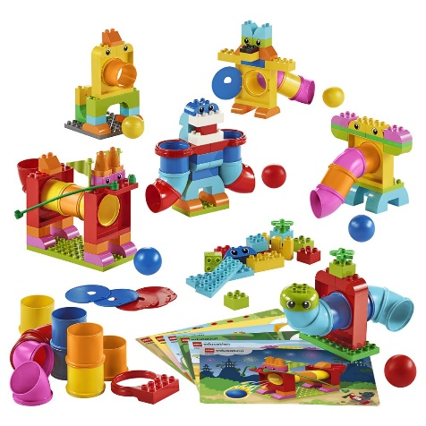
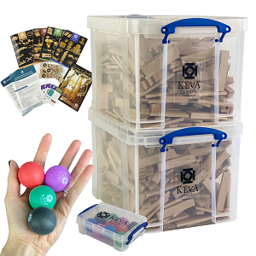
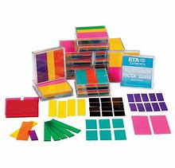
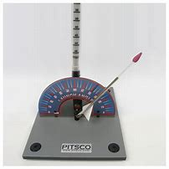
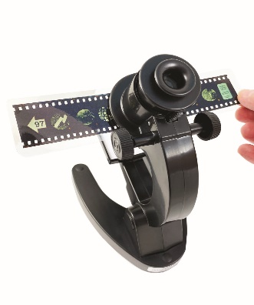
Welcome to the Southwest Indiana STEM Resource Center Virtual Presentation!
We invite you to click through the presentation to learn more about this one-of-a kind resource. The first part of the presentation gives you some background… but keep clicking to see examples of the over 1,000 pieces of STEM equipment available to you. We have been expanding our Elementary School resources, and we think you will love what you see.

Slide 2


SwISTEM Resource Center
Outreach Activities
Tri-State Science and Engineering Fair
First Lego League
Teacher Professional Development
Equipment Lending Service
Science Olympiad
Curriculum/ Instructional Assistance
Equipment Circulation
The Equipment Lending Service arm of the Resource Center has over 1,000 pieces of equipment that we lend… and we deliver and pick-up right to your school… all for FREE! If you have questions about other activities at the Resource Center, let us know.

Slide 3
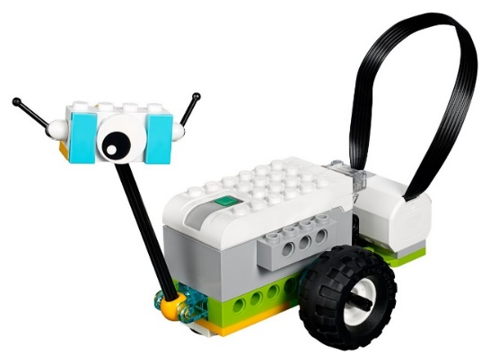
SwISTEM Equipment Lending Service
The Equipment Lending Service offers delivery to all schools in a 12-county area including Vanderburgh, Warrick, Posey, White, and Henderson counties. All items are loaned for 2-week periods, and most come with a curriculum or user’s guide. We are a completely FREE service funded by the University of Southern Indiana.
The STEM items we loan were all recommended by educators. It’s a fun and easy way to teach STEM concepts… we truly believe that hands-on STEM tools help students
love Science! And we make it easy
for you!

Slide 4
SwISTEM Equipment Lending Service
We recently completed a project to align our materials and activities to the Indiana Math, Science, Computer Science, and Engineering Standards. This is the perfect way to find materials to add to your lesson plans. All activities are free, need no log-in information AND have been test by local educators.
Kindergarten
1st Grade
2nd Grade
3rd Grade
4th Grade
5th Grade

Slide 5
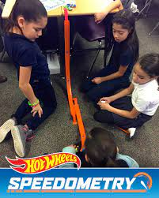
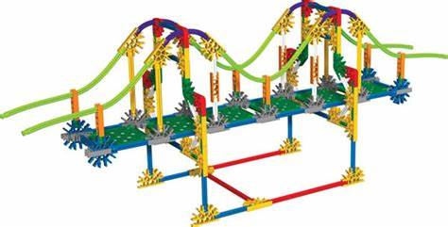
SwISTEM Equipment Lending Service
We have many materials designed for elementary (including pre-K) students.
The following slides highlight some of our most popular items for Elementary School
To go directly to our searchable equipment database, click here:
SwISTEM Equipment Database
Paper List of Available Equipment

Slide 6
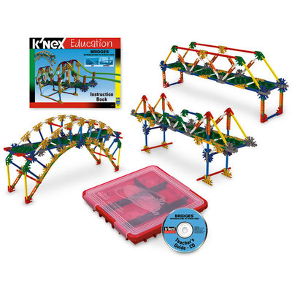
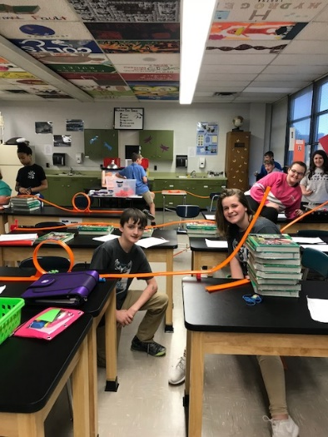
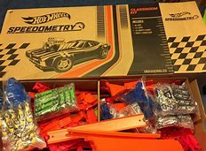
SwISTEM Equipment Lending Service
K-Nex Introduction to Bridges
This kit contains 207 pieces, including rods, stems, and connectors. Build 13 fully-functioning replicas of real-life bridges. These models help educate builders about bridge infrastructure by demonstrating key bridge types, such as truss, arch, cantilever, beam, suspension, movable/bascule, and cable-stayed. Building instructions and a teacher’s guide on a CD are included. Best for late Elementary or Middle School. More info: Introduction to Bridges Teacher Guide
Hot Wheels Speedometry Set
Our most popular Elementary School Item! Teaches about forces, motion, speed, and velocity with an issue to use curriculum. Has enough cars, tracks, and loops for a whole classroom. Perfect for all elementary grades, it comes with a Kindergarten and 4th grade curriculum easily adapted to any grade.
Kindergarten Curriculum
4th Grade Curriculum

Slide 7
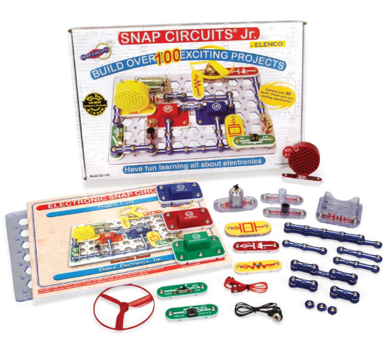
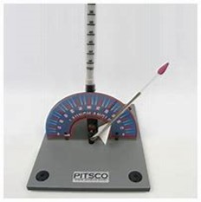
SwISTEM Equipment Lending Service
Snap Circuit Jr. and Snap Circuit Electricity Kits
Snap Circuits® Junior kits make learning about circuits easy and fun! Each student works with a partner– and each set comes with a workbook. We have 20 of these kits available!
You can also borrow our homemade Snap Circuit Electricity kits. They have on 20 pieces and focus only on circuits.
To see the easy-to-use curriculum for the Snap Circuit Electricity kits: Snap Circuit Curriculum
Straw Rocket Launchers
Each students receives their own straw to turn into a rocket! Our kit has all the supplies they need to create one… and then they are “launched” using our gentle rocket launcher (can be used in your classroom). Great way to teach graphing, precision/ accuracy, or basic engineering design. Very popular wherever they go! This quick video shows them in action: Straw Rocket Launchers

Slide 8
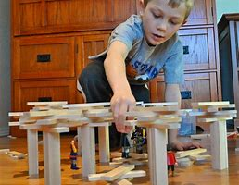
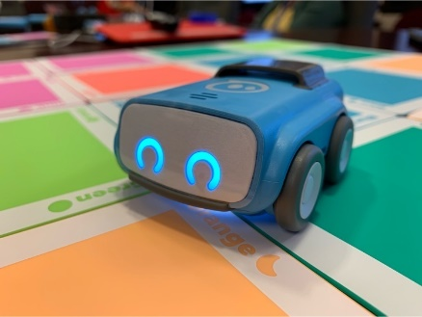
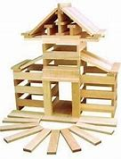
SwISTEM Equipment Lending Service
Keva Planks
Recommended by a local teacher, there is nothing that these planks cannot teach… and they can be used to meet almost any of the Engineering Design standards.
Each sets has 800 planks (enough for a whole class) and comes with an excellent Educator’s Guide, and for more ideas: Keva YouTube Channel
Indi Cars
Indi Cars by Sphero is a classroom set of cars to teach coding basic. No screen needed! Easy to use and fun! For a quick overview of Indi: Indi class pack video or see the Teacher Guide

Slide 9

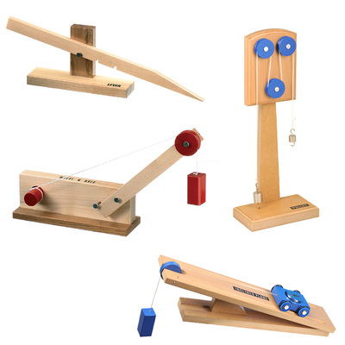
SwISTEM Equipment Lending Service
Lego We-Do Robotics Kits
Lego We-Do kits are perfect for teaching about coding
Each kit contains over 200 Legos as well as motors and sensors
Students also learn about building and following directions
We can loan up to 7 kits including I-Pads with the software downloaded; designed for 3rd-5th grades
Easy to use– most teachers tell us that the students were able to do the activities with minimal supervision
Lego We-Do Lessons
Simple Machine Model Sets
Precision-made wooden models demonstrate basic principles of work, force, and energy. Through hands-on exploration, students learn how machines can change the direction of a force, reduce work, or turn potential energy into kinetic energy. Each model is approximately 7" x 16". Example booklet (each model has a booklet):
Pulley

Slide 10
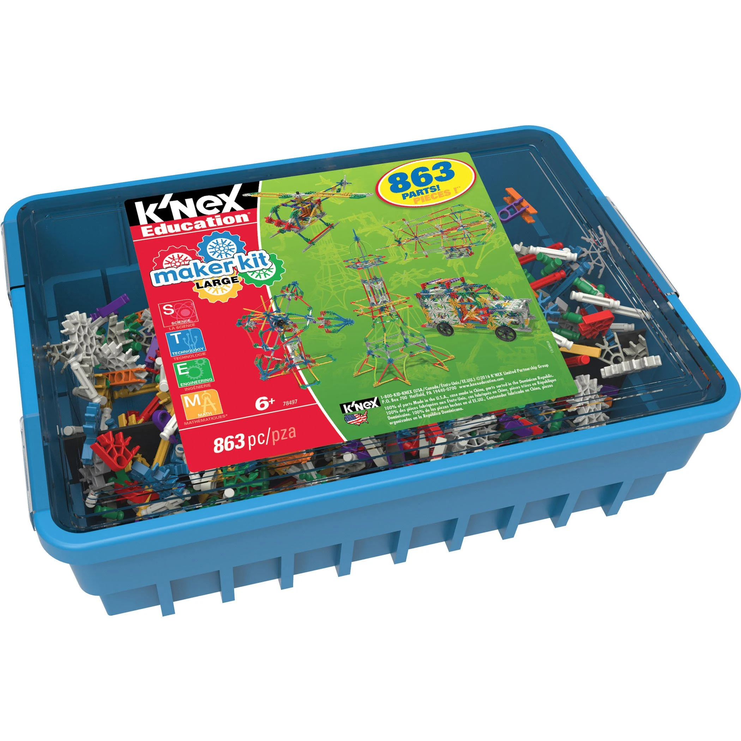
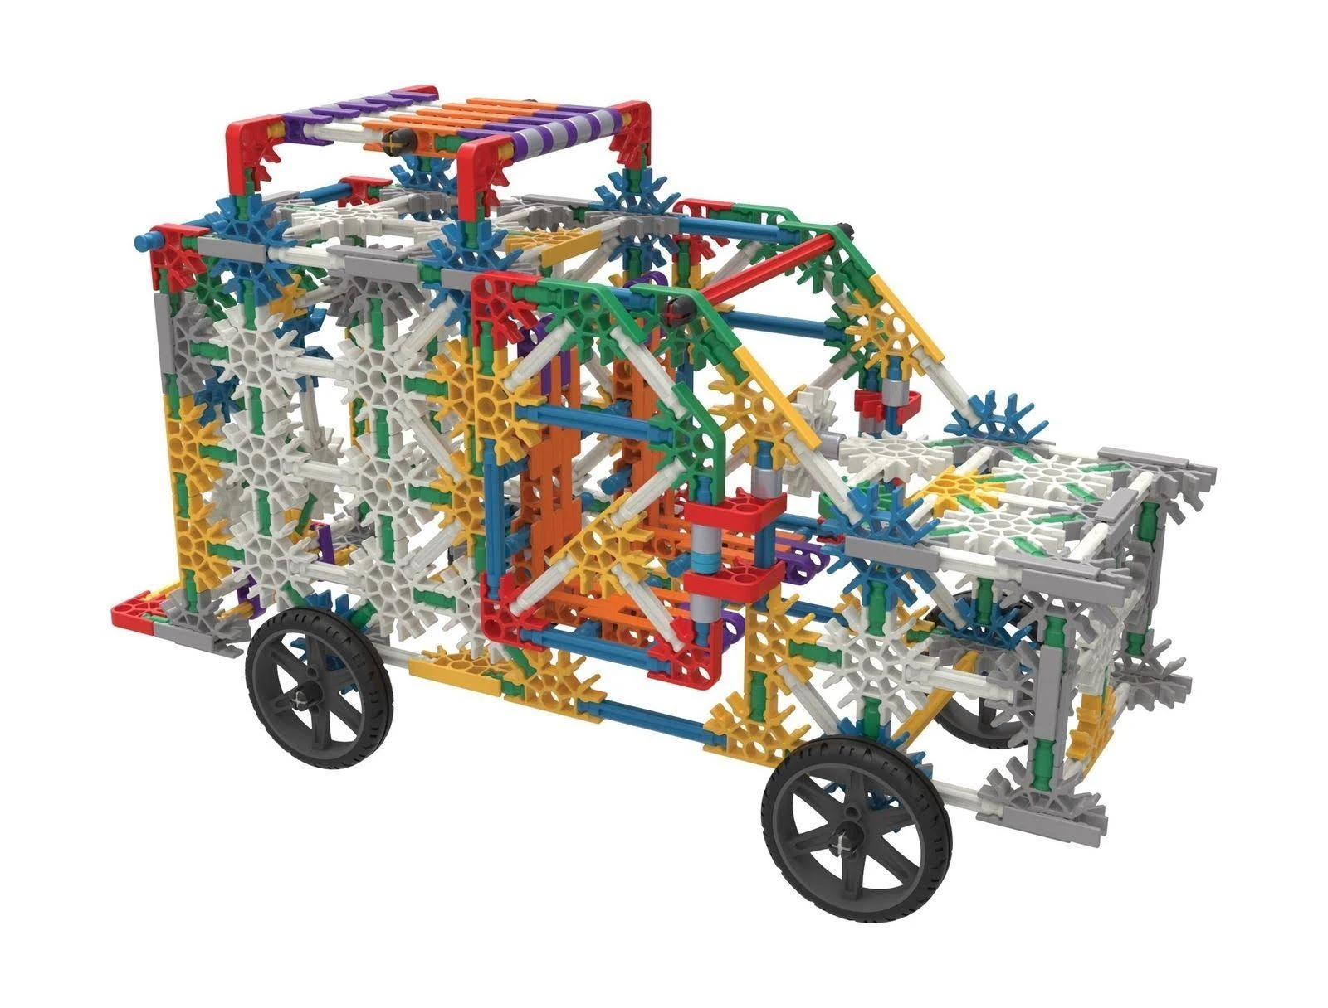
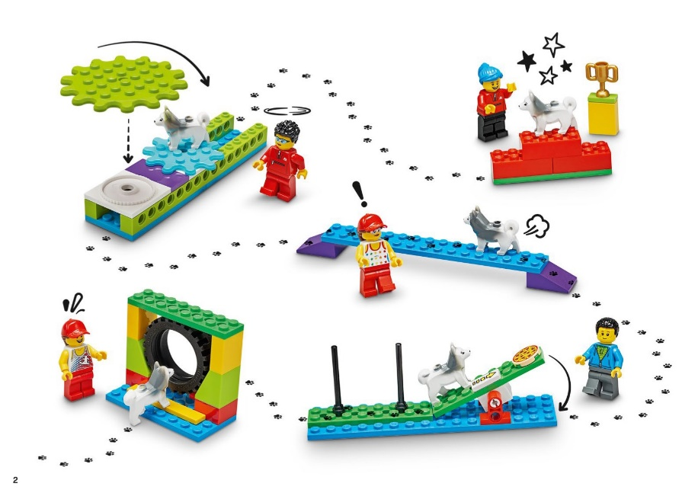
SwISTEM Equipment Lending Service
K-Nex Maker Kits
This kit contains 863 pieces, including rods, stems, and connectors. Students can free build or use the booklet to build structures like the Eiffel tower, cars, trucks, Ferris wheels, and more! Great for challenge activities (who can build the tallest structure? Who can make the best helicopter?) We have 14 of these set.
Maker Building Booklet
Lego BricQ Essentials
New to our inventory, these are a great way to teach basic building concepts and have a great time building with Legos. Students pair up to build a project using a building guide, and then try to optimize their design through experimentation. Curriculums for lower elementary as well as upper elementary. No tech needed!
Watch a quick video overview

Slide 11
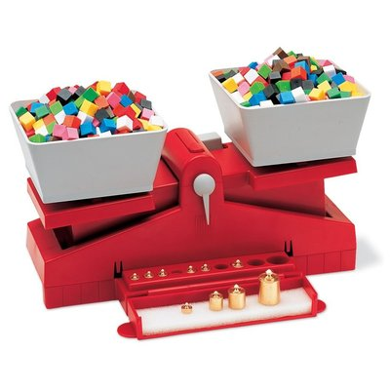
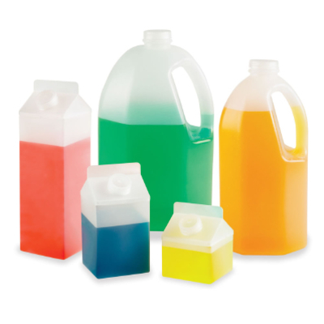
SwISTEM Equipment Lending Service
Measurement Equipment
We have several pieces of equipment that make teaching about measurement a piece of cake… okay, at least easier and more hands-on…
Meter Sticks
Measuring Tapes
Graduated Cylinders
Scales/ Balances
  Triple Beam Balances
  Elementary Balances (pictured)
  Digital Balances
Measuring Cups/ Tablespoons/ Teaspoons
Gallon Measurement Set (pictured)
Liter Measurement Set
Thermometers

Slide 12
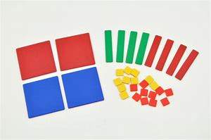
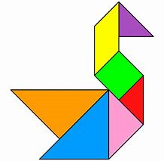
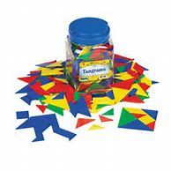
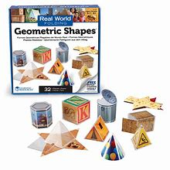
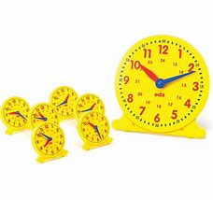
SwISTEM Equipment Lending Service
Math
We have many math manipulatives to make math more magnificent!
Algebra Tiles
Tangrams
Fraction Squares/ Circles
Folding Geometric Shapes
Clock Sets

Slide 13
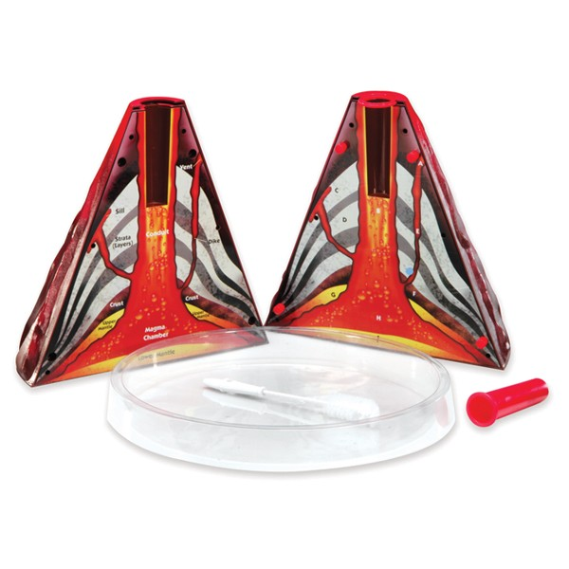
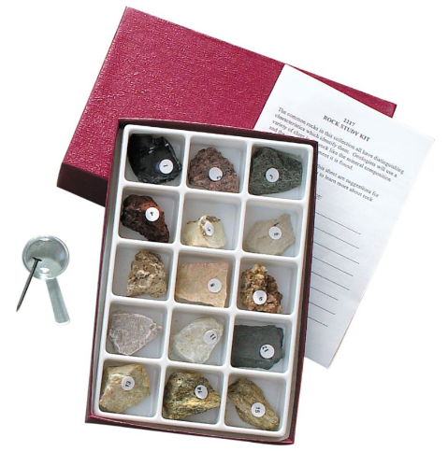
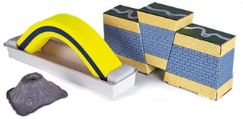
SwISTEM Equipment Lending Service
Earth Science
We have many different pieces of equipment designed to rock your Earth Science unit!
Volcano Models include recipe for lava!
Introduction to Rocks
Introduction to Minerals
  Request the Exploration Kit which includes Scratch Plates, Magnifying Lenses, and more
Fossil Sets
Geology Demonstration Kit
To let students see geology at a microscopic level, teachers also add Microslide Viewer Sets like:
  Rock and Forming Minerals
  Minerals and Crystal Systems

Slide 14
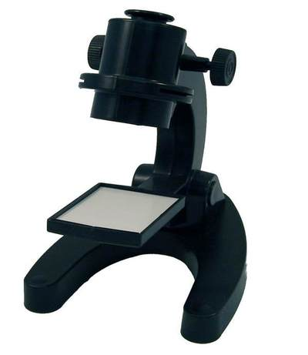

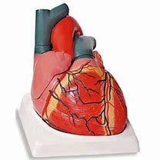
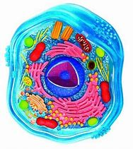
SwISTEM Equipment Lending Service
Biology
Introduce students to cells, human anatomy, and more!
3D Plant and Animal Cell Models
Giant Anatomy Models
  Lungs, Heart, Brain, Skin, Eye
Microscopes with Slide Sets
Microslide Viewers are microscopes without the hassle. Sets in our inventory include:
  Life in a Pond (link not available)
  Egg to Tadpole to Frog
  Cells of Plants and Animals

Slide 15
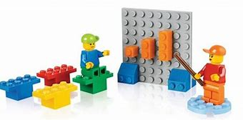
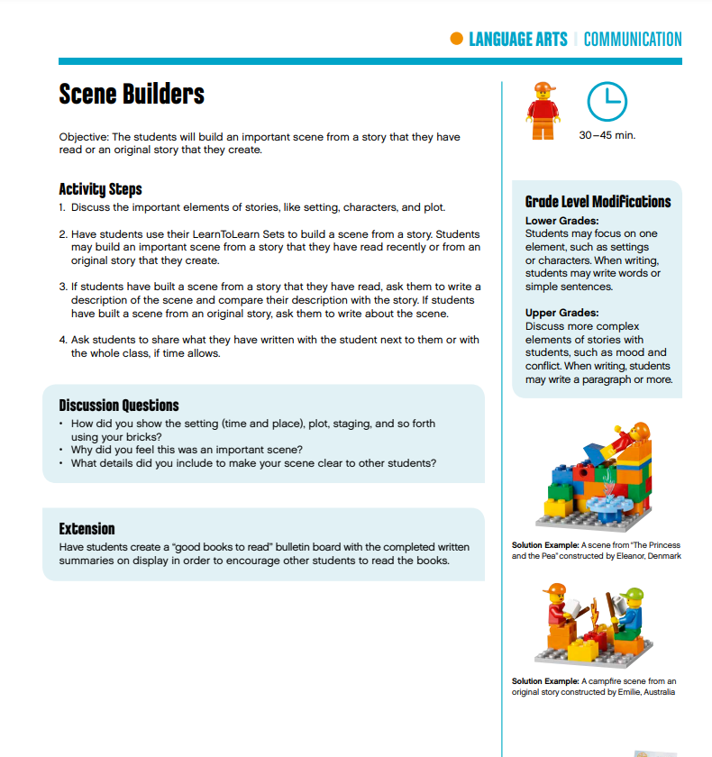
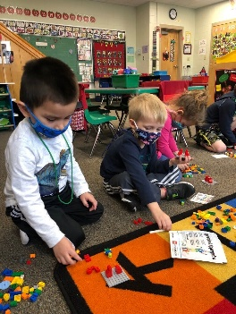
SwISTEM Equipment Lending Service
Lego Learn to Learn
Our most popular resource for lower elementary grades:
Each child has their own identical Lego container with 65 pieces
Can be used to teach colors, counting, shapes, symmetry
Excellent curriculum guide has activities for every subject from math to language arts
Lego Learn to Learn Curriculum Guide

Slide 16
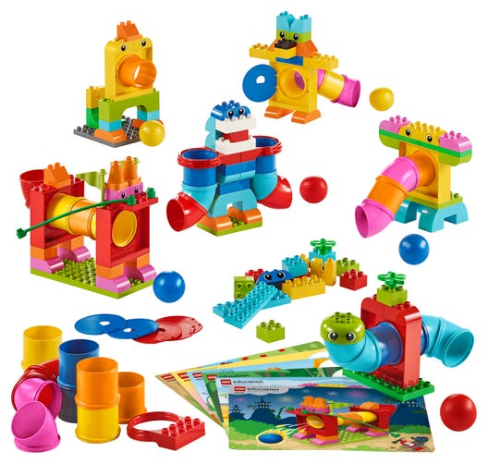
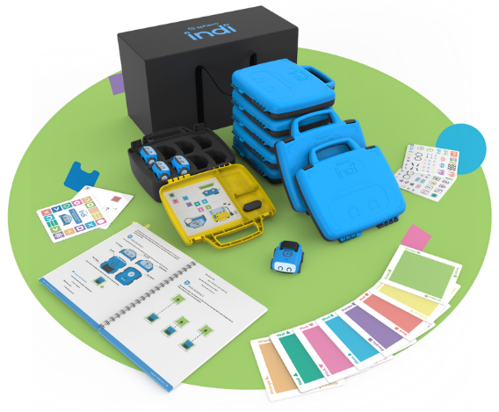
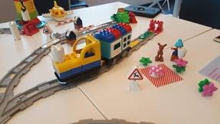
SwISTEM Equipment Lending Service
Pre-School Items
Most of the items in previous slides can be used with pre-school students, but we have a few items designed specially for the pre-school crowd!
Lego Tubes were recommended by a pre-school teacher and are a fun and educational way to teach building skills. We have three of these sets.
Indi by Sphero is a classroom set of cars to teach pre-schoolers the basics of coding. No screen needed. Easy to use and fun! For a quick overview of Indi: Indi class pack video
Lego Coding Express is set best for a group of 6-8 students (many teachers use this as a station). Teaches basic coding as well as building and problem solving! We have 3 of these sets.
Lego STEAM Park is similar to Lego Tubes but with gears and other more technical pieces. We have 3 of these sets.

Slide 17
SwISTEM Equipment Lending Service
Ready to Request Some Materials?
Go to our web site at www.usi.edu/STEM and click on the “Reserve” Button
OR just click here:
Reserve Materials
Still Have Questions?
We love to talk to customers. We are a small service, so we know how our materials are used by other educators and can help you pick the perfect materials for whatever STEM topic you are teaching!
So please… don’t hesitate to call or e-mail!!!
Paige: 812-205-5501
pdwalling@usi.edu

