Slide 1
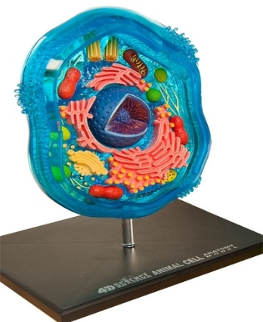
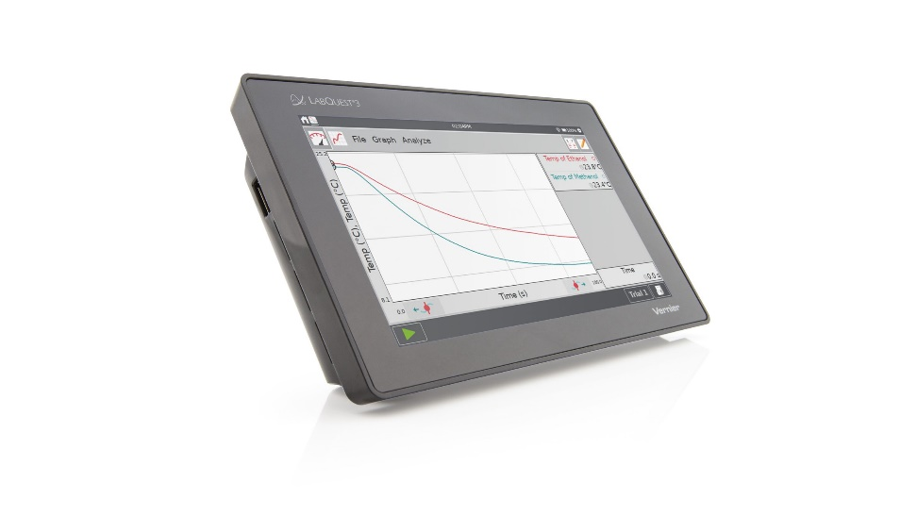
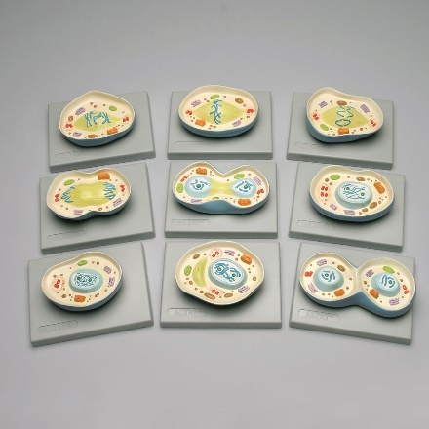
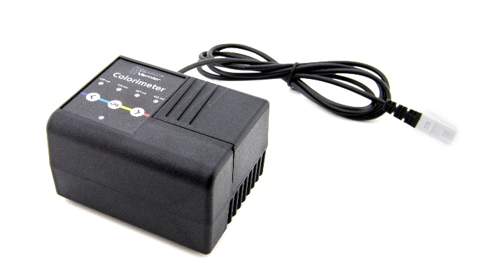
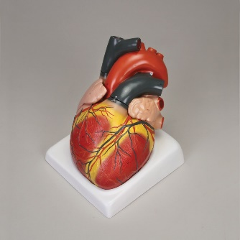
Welcome to the Southwest Indiana STEM Resource Center Virtual Presentation!
We invite you to click through the presentation to learn more about this one-of-a kind resource. The first part of the presentation gives you some background… but keep clicking to see examples of the over 1,000 pieces of STEM equipment available to you. We have many resources available for high school teachers. Several teachers also use our inventory to enhance what they already have in their classroom. So click through our presentation to see our most popular items and learn more about our FREE service!

Slide 2


SwISTEM Resource Center
Outreach Activities
Tri-State Science and Engineering Fair
First Lego League
Teacher Professional Development
Equipment Lending Service
Science Olympiad
Curriculum/ Instructional Assistance
Equipment Circulation
The Equipment Lending Service arm of the Resource Center has over 1,000 pieces of equipment that we lend… and we deliver and pick-up right to your school… all for FREE! If you have questions about any other arm (First Lego League, Science Fair, or Science Olympiad), just ask!

Slide 3
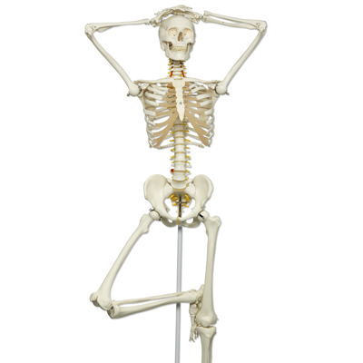
SwISTEM Equipment Lending Service
The Equipment Lending Service offers delivery to all schools in a 12-county region, including Vanderburgh, Warrick, and Posey counties. All items are loaned for 2-week periods, and most come with a curriculum or user’s guide. We are a completely FREE service funded by the University of Southern Indiana.
The STEM items we loan were all recommended by educators. And we have classroom sets of everything, so every student has a chance for hands-on STEM education. Our equipment is refurbished and replaced frequently– so you don’t have to worry about maintenance!
We are here to help with whatever STEM needs you have. And if you don’t see what you need, just ask. We frequently partner with USI Biology, Physics, Geology, and Chemistry departments to provide materials to schools.

Slide 4

SwISTEM Equipment Lending Service
We recently completed a document that links our equipment to Indiana Academic Standards. We have also linked labs (including labs using Vernier Equipment) and activities to the standards. We are working to add additional subjects, but we currently have links to:
High School Biology
High School Physics
High School ICP

Slide 5
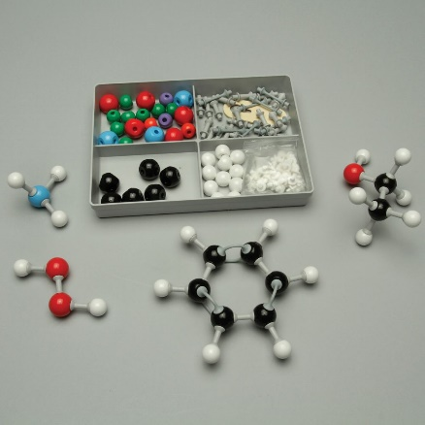
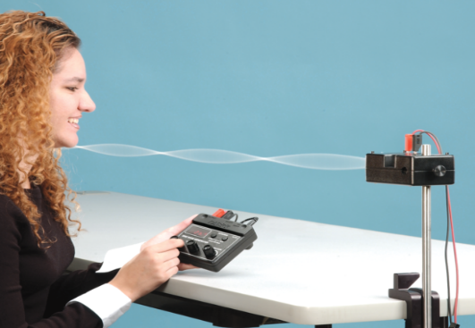
SwISTEM Equipment Lending Service
Our inventory includes almost every Vernier sensor, over 30 Labquests (including the new Labquest 3), giant anatomical models, cell biology manipulatives, and many hands-on physics activities.
The following slides highlight some of our most popular items for High School.
To go directly to our searchable equipment database OR to print a paper copy of our inventory, click here:
SwISTEM Equipment Database
Paper List of Available Equipment

Slide 6

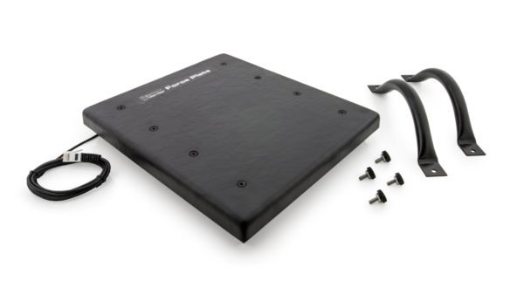
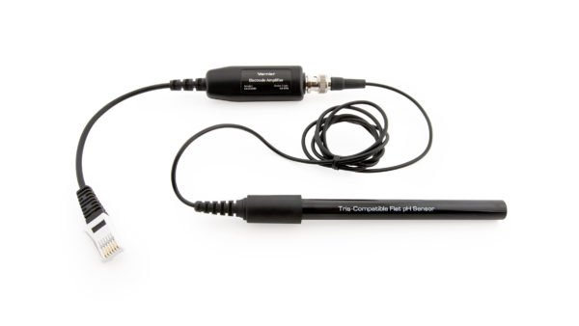
SwISTEM Equipment Lending Service
Vernier Lab Quests
We have over 30 Vernier Labquest 2 and 3. Vernier Labquests are perfect for data collection of all sorts. We have 49 different probes/ sensors that can be used with them. The Labquests can be used as stand-alone units, or the Vernier software can be downloaded to a phone or laptop. Vernier even has pre-made labs that give detailed step-by-step directions. We have all Vernier Laboratory guides available electronically OR we can also loan out our paper manuals (see next slide).
Some of our most popular Vernier sensors:
Chemistry/ Biology: Physics:
Dissolved Oxygen Probe Current Probes
Colorimeters Dual Range Force Sensors
Temperature Probes Force Plates
pH Sensors Photogate Timers
Gas Pressure Sensors Low-G Accelerometers
EKG Sensors
Hand-Grip Heart Rate Monitors

Slide 7
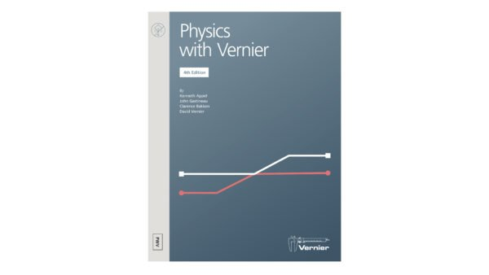

SwISTEM Equipment Lending Service
Electronic Links to Vernier Laboratory Manuals
We have paper copies of the Vernier manuals available for loan, and we have electronic links to many of those. Click on the links below to see the easy-to-follow labs provide by the Vernier company! We have paper copies but no electronic link to Engineering Projects and Environmental Science.
Chemistry/ Biology: Physics:
Advanced Biology with Vernier Exploring Motion and Force with Go Direct Sensor Cart
Advanced Chemistry with Vernier Physics with Vernier
Biology with Vernier Sensor Cart Physics
Chemistry with Vernier
Earth Science with Vernier
Forensics with Vernier
Human Physiology with Vernier
We also have links to the lab directions using a Labquest 2 or 3– if you don’t want to use any other software. E-Mail Paige at pdwalling@usi.edu to get a link directly to the Labquest directions for any of the manuals listed above.

Slide 8
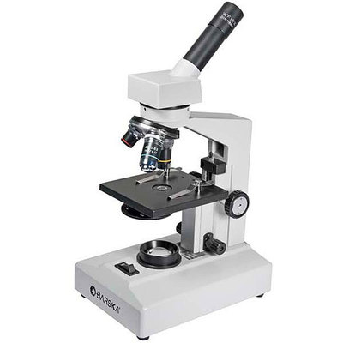


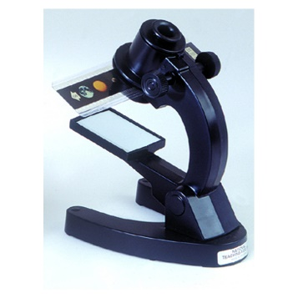
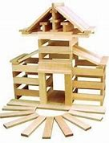
SwISTEM Equipment Lending Service
Cell Biology Resources
We have many choices to aid with teaching cell biology. Most teachers borrow more than one at a time, so feel to request multiple items (click on the resource to see a picture and description)!
Microscopes: We have over 20 high quality microscopes. We even have a few battery-operated microscopes if you don’t have enough electrical outlets in your room. We can also provide prepared slide sets. We have several choices, including Beginner’s Biology and Plants and Animals
3D Cell Models: We have 30 of each of both Plant and Animal cell models. These are great because students can take them apart and “feel” a cell. They also come with a helpful booklet.
Giant Animal Cell: We have a giant animal cell model for classroom demonstration purposes.
Microslide Viewers: Perfect for introductory level high school classes, Microslide Viewers provide a microscope experience without the hassle. The viewers work with slide sets, including Animal Mitosis, Cells of Plants and Animals, Meiosis, and Plant Mitosis. Each set comes with student worksheets and slide descriptions.
Cell Mitosis Model Set: This demonstration set has a model for each stage of Mitosis. Each stage is labelled on the back, so it is perfect for quizzes or review.
Cell Meiosis Model Set: Like the Mitosis set, this model includes each stage of meiosis.
Magnetic Animal Cell: Giant Model of the cell (including removeable parts) that adheres to any magnetic Surface

Slide 9
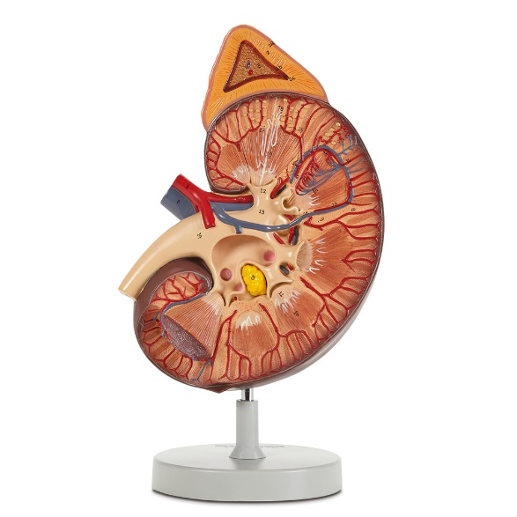
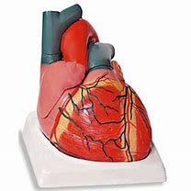
SwISTEM Equipment Lending Service
Giant Body Systems/ Organs
We have high-quality, medical grade models available:
Giant brain
Giant eye
Giant ear
Giant heart
Lifesize heart
Giant Lungs
Giant Respiratory System
Giant kidney
Skeleton
Disarticulated Skeleton (box of bones)
All models have keys and are designed for demonstration purposes. Because they are for demonstration, we only have 1 of each model.
Note: Carefree attitude NOT included. Feel free to give him any attitude you want!

Slide 10

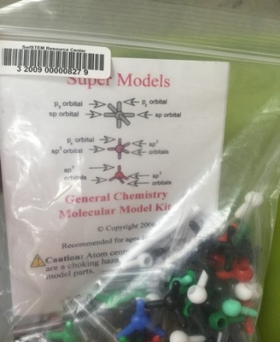
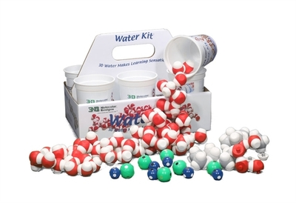
SwISTEM Equipment Lending Service
Organic Chemistry Model Sets
We have 14 sets of high-quality Organic Chemistry Model sets. Comes with a basic building guide.
General Chemistry Model Sets
We have 14 sets of high-quality General Chemistry Model sets. Great for hands-on learning!
Magnetic Water Molecules
These very popular kits come with an excellent teacher guide as well as up to 20 sets of magnetic water molecule sets. Magnets embedded in the atom centers let students see and feel simulated molecular attraction or repulsion, making fundamental molecular interactions easier to comprehend.
Quick Water Molecule Overview Video

Slide 11
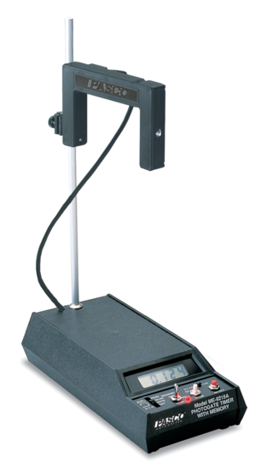
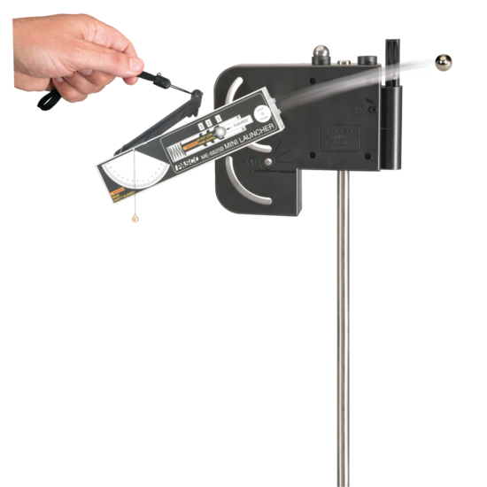
SwISTEM Equipment Lending Service
Photogates
We have two types of photogates, and both are perfect for Physics labs! One is by Vernier and can be used with the Vernier Labquest. The other is a Pasco photogate timer and can be used as a stand-alone unit.
Vernier Photogate
Pasco Photogate Timer
Mini-Launcher
The Mini Launcher allows students to thoroughly investigate projectile motion. With three, highly repeatable launch speeds, precise launch angle measurements, and the ability to shoot downward, the Mini Launcher enables students to explore projectiles through dynamic, hands-on inquiry. Check out the teacher manual to see how you could use this launcher in your classroom!

Slide 12
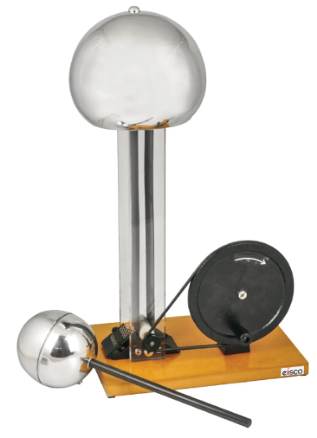
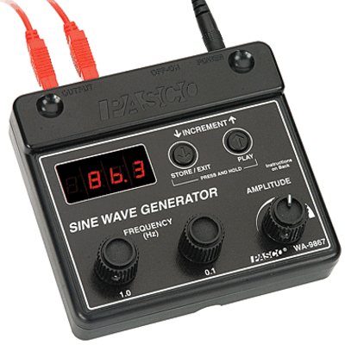

SwISTEM Equipment Lending Service
Hand Cranked Electrostatic Generator
Also known as a van de graaf generator, this item allows you to perform basic electrostatic demonstrations. It comes with an electrostatics kit that contains items like fur and tin plates to enhance your demonstration! Raise your hair and demonstrate the fun of science!
Video on Electrostatic Generators
String Vibrator and Sine Wave Generators
String Vibrators and Sine Wave Generators allow students to study the fundamental characteristics of mechanical waves including wave speed, frequency, wavelength, amplitude, interference and resonance. We can also provide ring stands and c-clamps if needed.
High School Standing Wave Lab

Slide 13
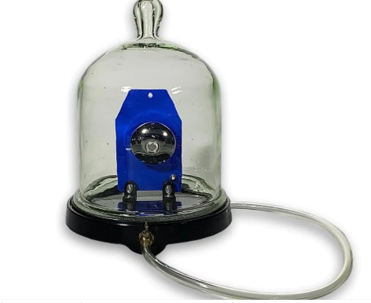
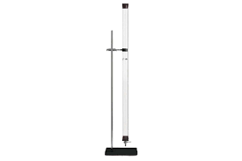
SwISTEM Equipment Lending Service
Bell Jar and Ringer
New to our inventory this year, the Bell Jar and Ringer is perfect for illustrating how sounds needs a medium through. Request our vacuum pump when borrowing this item! For more information, see the Teacher Guide.
Coin and Feather Demo
An easy way to show the classic demonstration of how lighter and heavier objects fall at the same rate when air resistance is removed. Request our vacuum pump when borrowing. To see a similar device in action, watch the Coin and Feather Demo Video. You can also check out the Teacher Guide.

Slide 14
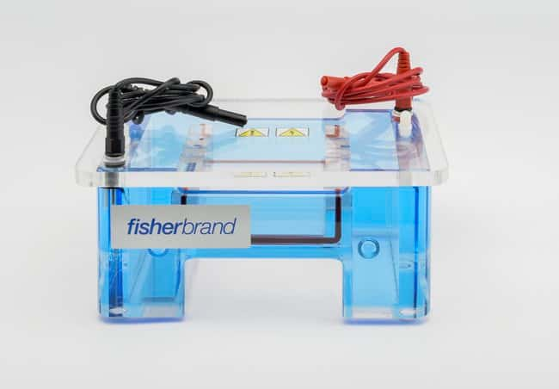
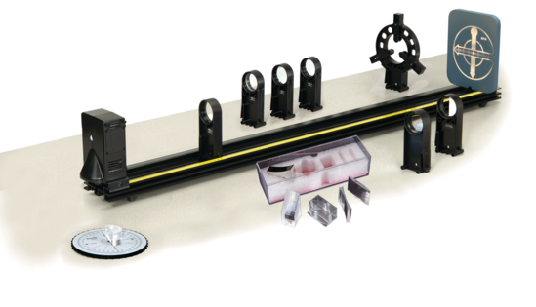
SwISTEM Equipment Lending Service
Electrophoresis Equipment
We have 6 sets of horizontal electrophoresis sets, including apparatus, combs, and power sources. We do not provide the gel. Our sets are easy-to-use and we can even provide micropipettes if needed! We also have vortexers, light boxes, and mini-centrifuges.
Basic Optics System
The Basic Optics System comes with all materials shown, including the optics bench. Perfect for labs on prisms, Snell’s law, and focal length. To see the labs you can do with the Basic Optics System:
Basic Optics System Manual and Labs

Slide 15
SwISTEM Equipment Lending Service
Ready to Request Some Materials?
Go to our web site at Equipment Lending Service and click on the “Reserve” Button
OR just click here:
Reserve Materials
Still Have Questions?
We love to talk to customers. We are a small service, so we know how our materials are used by other educators and can help you pick the perfect materials for whatever STEM topic you are teaching!
So please… don’t hesitate to call or e-mail!!!
Paige: 812-205-5501
pdwalling@usi.edu

